Slide 1
FET National Strategy: Skills for the Green Economy
Information Pack for Sectoral Stakeholders
—
April 2024

Slide 2
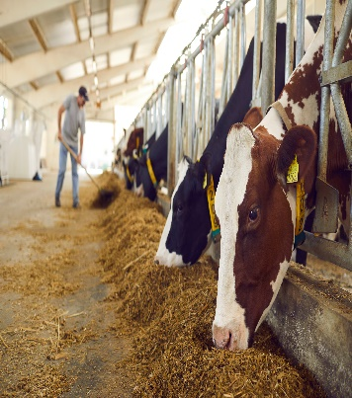
FET Skills for the Green Economy
SOLAS have commissioned KPMG to produce a body of research to aid in developing a policy position and to formulate a strategy for the FET sector to deliver on skills for the green transition.
The demand for skills for the green economy within an Irish context is evidenced within policy and strategy from both EU and national directives. In this context, there is a huge opportunity for the Irish Further Education and Training (FET) Sector to respond to the climate crisis through the provision of skills-based training for the Green Transition.
Irish and EU Policies relevant for Green Skills:
The European Green Deal 2019
Future Jobs Ireland 2019
Programme for Government 2020
The Osnabrück Declaration on Vocational Education and Training 2020
Skills for Zero-Carbon 2021
Housing for All 2021
Action Plan for Apprenticeships 2021-2025
Climate Action Plan 2023
National FET Strategy 2021-2024
Green Skills for FET 2021-2030 Roadmap

Slide 3
FET Skills for the Green Economy
Building on progress to date, which includes SOLAS’s own “Green Skills for FET 2021-2030 Roadmap”, there is a need to develop a clear, comprehensive, and actionable framework for the FET sector to deliver on skills for the zero carbon economy, which SOLAS can use to guide collaborative work with the 16 Education and Training Boards in the development of relevant programmes.
‘Climate change and sustainable development must also be a critical focus for FET, with a strong contribution to the Government’s call to action by building on FET’s strong capabilities around energy, building, and the environment. This will be central to the modernisation of construction skills, as innovating access in construction and skills related areas is vital. Perhaps most critically, there should be emphasis on ensuring that all FET provision is used to develop critical climate change and environmental knowledge, and that FET campuses are based on a strong sustainability ethos.’
National FET Strategy 2021 to 2024, p.43
As part of this project, KPMG will be undertaking a systematic quantitative and qualitative assessment of green skills required within the context of existing, emerging, and supporting occupations across several key sectors in the Irish economy. This exercise will require extensive stakeholder engagement that will be carried out between April and June 2024.

Slide 4
FET Skills for the Green Economy
As demonstrated by international best practice in green skills identification and monitoring, stakeholder engagement is a critical element of any approach to assessing green skills needs at a national level.
This pre-consultation pack provides a brief overview of the project; an outline of key timelines; and details the process for stakeholders to engage with the team throughout the development of the Skills for the Green Economy Strategy.
The Skills for the Green Economy Strategy involves four distinct phases of stakeholder engagement:
Method development engagement to ensure that the best approach is taken for developing the Skills for the Green Economy Strategy.
Awareness building to introduce stakeholders to project, generate buy-in, and address any queries that arise.
Engagement for Green Skills Identification to provide detailed information on the specific skills needed for the green transition.
Final report engagement with stakeholders to finalise the consultation’s findings.

Slide 5
Stakeholder Engagement
Broadly, the stakeholder engagement process for this project is designed to incorporate three distinct stakeholder groups (as set out below). Each stage of the stakeholder engagement process will target different stakeholder groups – depending on the specific requirements of that stage.
Project Steering Committee
Sectoral & Government
FET (ETBs)
Green Skills Stakeholder Engagement Process
1. Steering Committee: The Project Steering Committee will be central to guiding the high-level structure as well as strategic direction of the Skills for the Green Economy Strategy – inclusive of method development. This group will provide direction on strategy content and participate in the review of draft documents.
2. FET Stakeholders: The FET stakeholders group will include representatives of the 16 Education and Training Boards (ETBs). This group will provide invaluable cross-sectoral insights in terms of the possible tertiary pathways between further and higher education that could be explored to meet the green skills needs identified by sectoral stakeholders; as well as the indicative programmes that could be developed by the FET network to meet the identified skills need including the range of FET provision (e.g., PLC, community education, adult education, traineeships etc.).
3. Sectoral & Government: The Sectoral and Government stakeholder group will serve a crucial role in the green skills identification exercises undertaken across WP3. The ‘inform’ stage of the process will be crucial in establishing buy-in across these stakeholders. In particular, the development of a pre-consultation pack will inform stakeholders of the purpose and process of the project, as well as set out the expectations for stakeholders as part of their engagement with the assessment.

Slide 6
Key Stages of Stakeholder Engagement
Stage 1: Method Development Engagement
The objective of this sub-task is to ensure that relevant methodological considerations are assessed in determining the best approach for the development of the Skills for the Green Economy Strategy.
Feb
An occupational analysis to identify the specific roles that stakeholders will be asked to comment on.
Research team
Mar
A stakeholder mapping exercise to identify representative bodies for all the occupations to be surveyed.
Research team
May
An online workshop to present initial findings from the surveys and agree on the structure of the sectoral and ETBs workshops.
Research team
Steering Committee
Stage 2: Awareness Building
The overarching aim of this sub-task is to introduce the FET, government, and sectoral stakeholders to the project, in terms of the intention to develop the Skills for the Green Economy Strategy and the role of stakeholders across the process
Develop a pre-consultation package to detail the role of stakeholders throughout the project, providing stakeholders clarity on the expectations and extent of their involvement. The pack will also outline the purpose, rationale, and method to develop the Skills for the Green Economy Strategy as clearly as possible, so that all stakeholders gain a solid understanding of the project.
Mar
Research team
All stakeholders
Stage 3: Engagement for Green Skills Identification
Detailed analysis will need to provide detailed information on the specific skills required for the greening of existing, new, and emerging green occupations at levels 1-6 on the NFQ, as well as illustrate possible tertiary pathways between further and higher education to meet the identified skills need.
Apr
A targeted online survey to develop a long list of required green skills.
Sectoral & Government
FET (ETBs)
May
A series of online workshops to validate and finalise the green skills list.
Sectoral & Government
FET (ETBs)
May
An online workshop with ETBs to review the survey findings.
FET (ETBs)
Stage 4: Final Report Engagement
Jun
Development of consultation report with stakeholder input on draft version.
Steering Committee

Slide 7
Final Reports
The Consultation Report that will be produced as the stakeholder engagement process concludes will be a concise document that will summarises the findings gathered from the various stakeholder engagement activities of the project. The report will include significant elements of stakeholder input. A draft of the report will be shared with key stakeholders, followed by an online (or in person if desired) workshop to discuss the feedback and agree on any required changes.
June
Draft version of the consultation report will be shared with stakeholders for review.
July to August
Revised report findings feeding into the “Detailed Analysis” and “Recommendations” phases of the project. .
July
Stakeholder feedback received through online/in-person workshop.

Slide 8
Online Surveys
As part of stakeholder engagement for the FET National Strategy: Skills for the Green Economy, stakeholder groups are invited to complete an online survey. These online surveys are intended to gather initial stakeholder input on the greening of core occupations, which will be further validated and enhanced through stakeholder workshops.
Sectoral Stakeholders Survey
https://www.surveymonkey.com/r/SOLAS_Sectoral_Survey

Slide 9
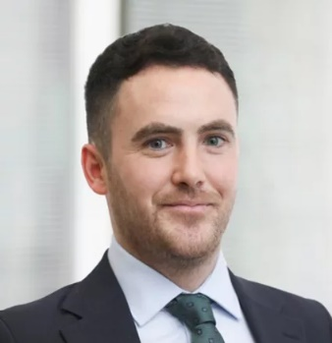
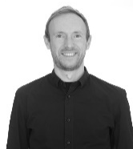
The KPMG Team
KPMG TEAM
Project Director
Team Leader
Dr William Hynes
Dr Daragh McGreal Director, Head of Strategic Economics
Oversight \ SMEs
Managing Director Project Director
Project Manager
Day-to-Day Manager
Dr Aoife Doyle
Dr Cristina Bucur Manager
Research/Engagement Lead
Associate Director
Engagement Oversight
Core Delivery Team
Patrick Lohr Senior Consultant
Data Lead
Michael Costello Consultant
Engagement Support
John Sheils Consultant
Research Support

Slide 10
Contact Us
Please feel free to reach out to any of the Engagement Team members throughout the process regarding queries, clarifications and concerns.
Dr. Aoife Doyle
Engagement Oversight
aoife.doyle@kpmg.ie
Dr. Cristina Bucur
Engagement Lead
cristina.bucur@kpmg.ie
Michael Costello
Engagement Support
michael.costello@kpmg.ie

